Slide 1
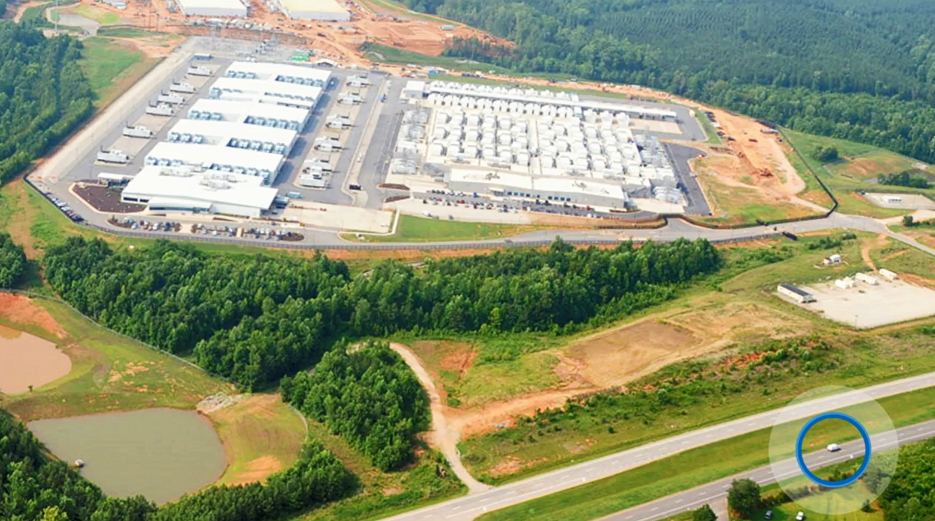
Microsoft Azure Services Overview
David.Gristwood@microsoft.com
@ScroffTheBad

Slide 2
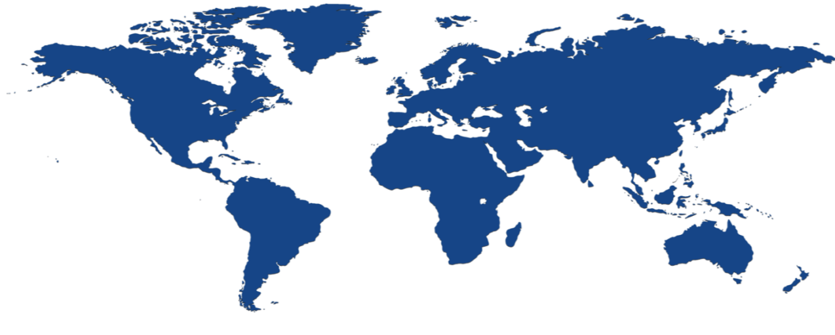


Microsoft Azure Locations
40 Cloud regions worldwide
United Kingdom South
North Central US
United Kingdom West
West Europe
West US 2
Central US
Canada Central
Germany Northeast²
US Gov Iowa
Canada East
North Europe
Korea Central
France³
Germany Central²
Korea South
West Central US
East US
France³
China West¹
Japan East
West US
US DoD West
Japan West
US Gov Arizona
East US 2
China East¹
US Gov Texas
US Gov Virginia
West India
South Central US
US DoD East
East Asia
Central India
South India
100+ datacenters
One of 3 largest networks in the world
¹China datacenters operated by 21 Vianet
²German data trustee services provided by T-systems
³France has been announced (due 2017)
⁴South Africa has been announced (due 2018)
Southeast Asia
Brazil South
S.Africa⁴
Cape Town
S.Africa⁴
Jo’Burg
Australia East
Australia Southeast
Global datacenters
Chinese datacenters
US Gov datacenters
German datacenters

Slide 3
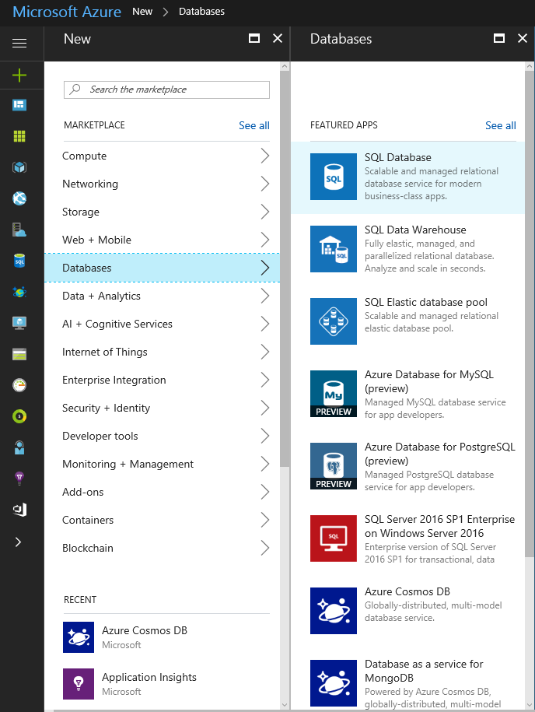
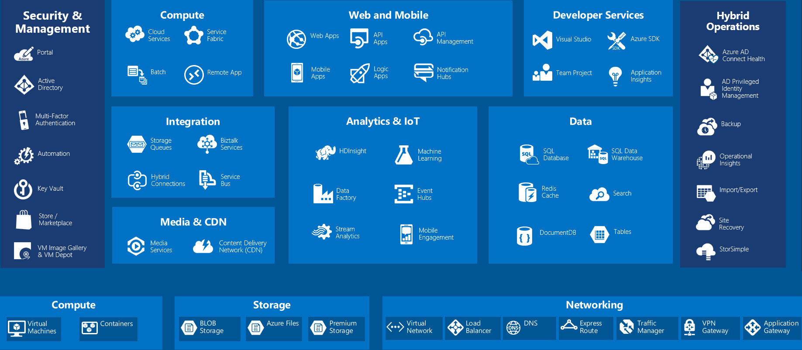
Azure Portal

Slide 4
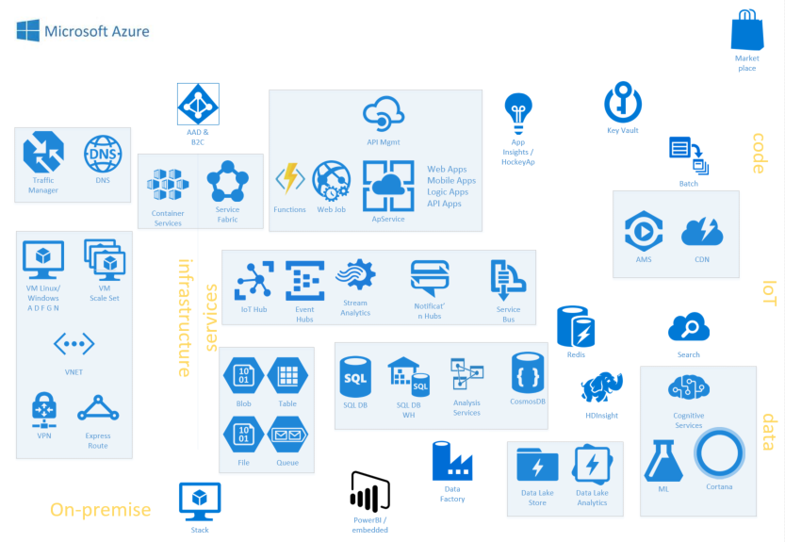

Slide 5
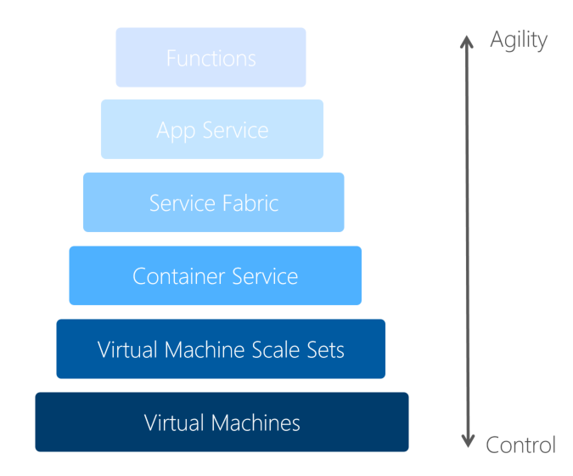
Code

Slide 6
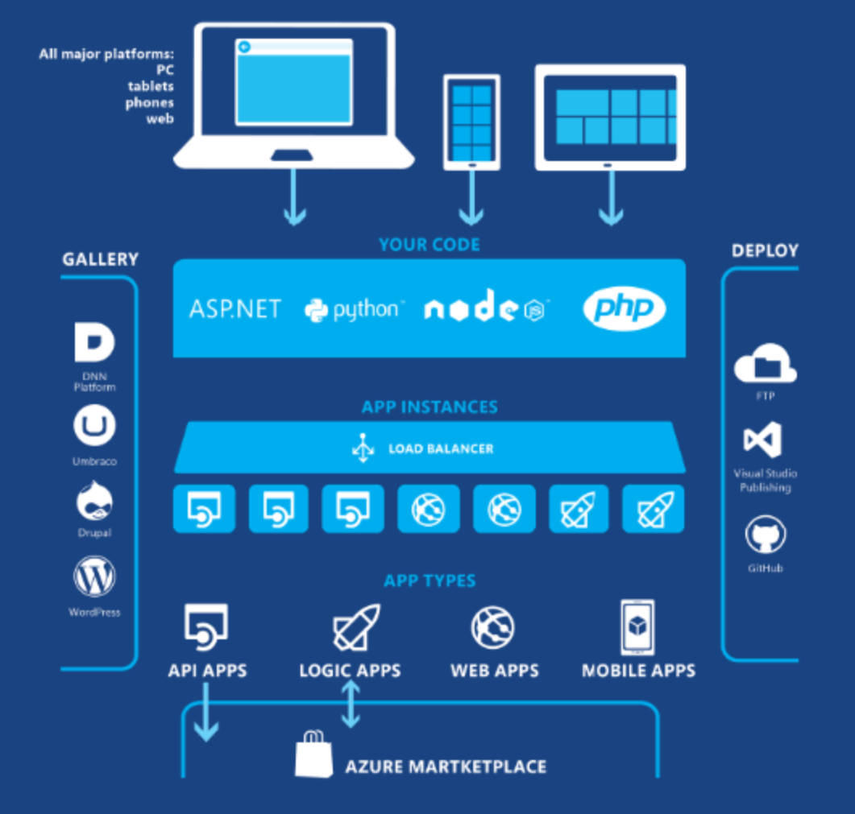
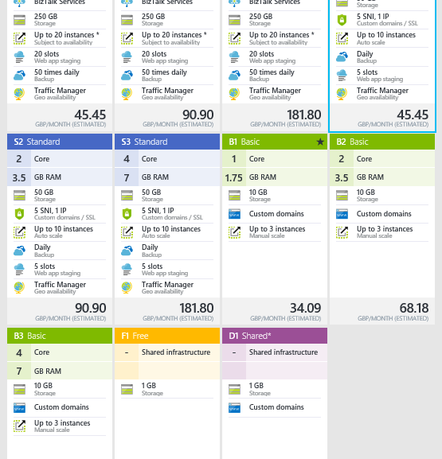
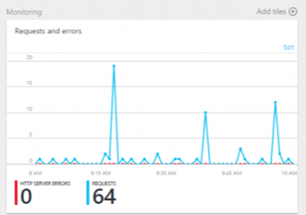
Azure App Services Quickly create powerful cloud apps for web and mobile clients
Fully-managed platform and app hosting aka “Web site as a service”
Auto-scale, monitoring, …
Pay only for the functionality you need

Slide 7
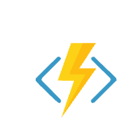
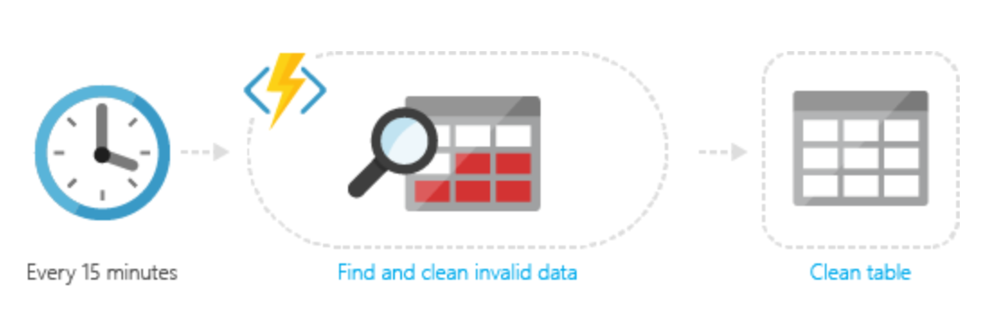
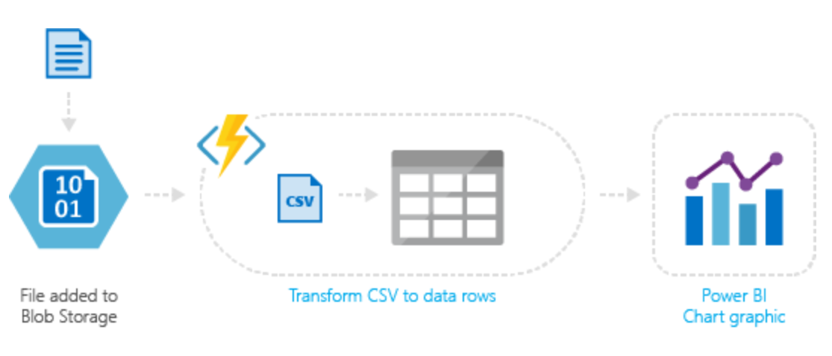
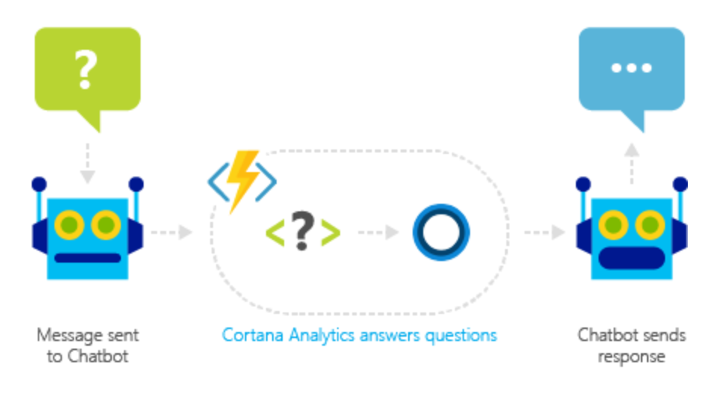
Azure Functions
Develop serverless architectures
Event driven model – timers, webhooks, queues, Service Bus, EventHub, …
Pay only for what you use
JavaScript, C#, Python, PHP, Bash, Batch, PowerShell or any executable
Functions runtime is open-source, available on GitHub

Slide 8
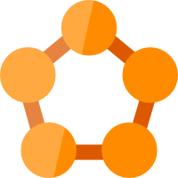
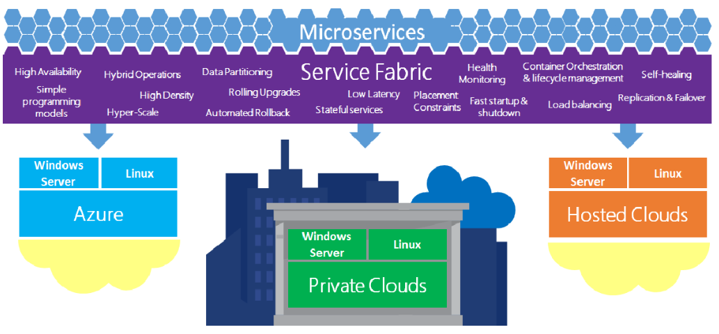
Service Fabric A Microservices Platform
Powers many Microsoft services:
Azure SQL Database, Azure Cosmos DB, Cortana, Power BI, Intune, IoT Hub, …
Windows and Linux Containers
Stateless and stateful microservices
Service Fabric programming models

Slide 9


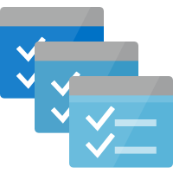
Deploy containers everywhere in Azure
Container Service
Service Fabric
Web Apps
Batch
Kubernetes
Mesos DC/OS
Docker Swarm

Slide 10
Data
Human derived data
(sales, orders, parts, invoices, inventory, etc)
Machine derived data
(telemetry, sensor, movement,
GPS, etc)
Transactional integrity, relational, etc.
Stand alone, variable quality, distributed, etc.

Slide 11
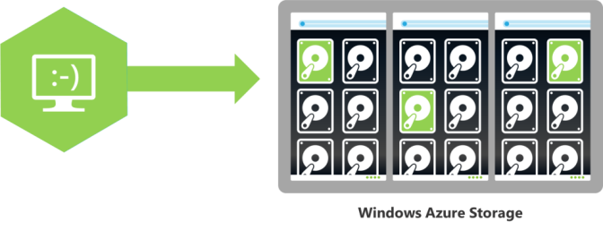
Azure Storage
Cloud storage solution for modern applications that rely on durability, availability, and scalability
Massively scalable, highly available data store for hundreds of terabytes of data
Used by Skype, Office 365, Xbox, OneDrive,…
Never loose your data - locally redundant through to read-access geo-redundant
Hot (normal) and Cool (archive) blobs
Encryption at rest
Pay for what you use
Starts from $0.02 per GB per month
Blobs
Highly scalable, REST based cloud document store
Block Blobs: Sequential file I/O
Cool Tier Available
Page Blobs: Random-write pattern data
Append Blobs
Tables
Massive auto-scaling NoSQL store
Dynamic scaling based on load
Scale to PBs of table data
Fast key/value lookups
Queues
Reliable queues at scale for cloud services
Decouple and scale components
Message visibility timeout and update message to protect against unreliable dequeuers
Notes:
https://docs.microsoft.com/en-gb/azure/storage/storage-table-design-guide
https://docs.microsoft.com/en-us/azure/azure-subscription-service-limits
Up to 20,000 IOPS, entities per second, or messages per second / account

Slide 12
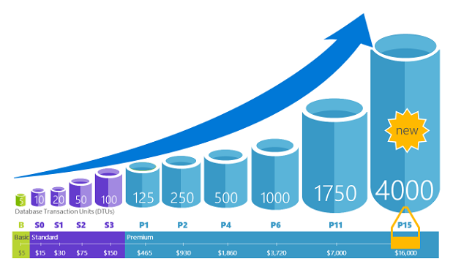
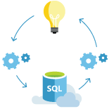
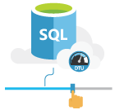
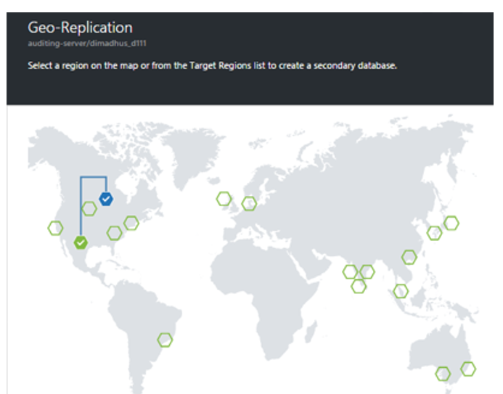
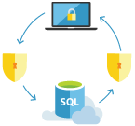
SQL Database
Relational database service with mission-critical capabilities, delivering predictable performance, scalability with no downtime, business continuity and data protection, all with minimal administration
“Database as a service”
Highly compatible SQL Sever engine
Scale performance on the fly, without app downtime via service tiers
Basic: 2 GB max size, 30 sessions
Standard: 250 GB max size, 200 sessions
Premium: 4TB max size, 400 sessions
Database Transaction Units (DTUs) workload
Point in time restore, Active Geo-Replication
New Azure Database Migration Service
PostgreSQL as a Service
MySQL as a Service
Notes:
https://docs.microsoft.com/en-us/azure/sql-database/sql-database-scale-up

Slide 13
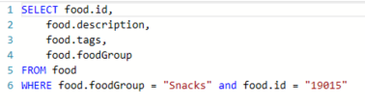
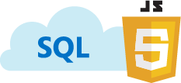
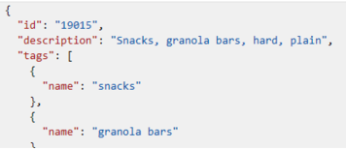
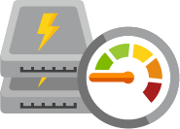
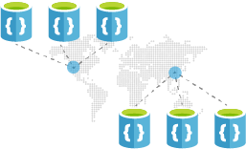
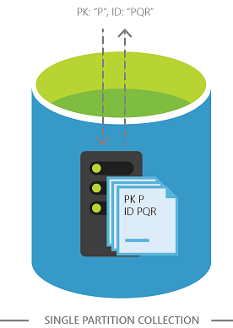
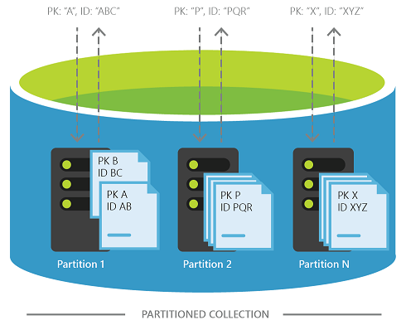
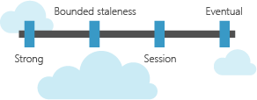
Azure Cosmos DB
Evolution of DocumentDB, as a blazing fast, planet-scale NoSQL store
Replicate and scale data globally
Transparent partitioning
Replicates your data to any number of regions worldwide
APIs
DocumentDB NoSQL, MongoDB, Premium Table storage, Gremlin Graph, Spark
Guaranteed low latency
< 10 ms on reads, < 15 ms on writes
Choice of four consistency models
Strong, bounded staleness, session, & Eventual

Slide 14
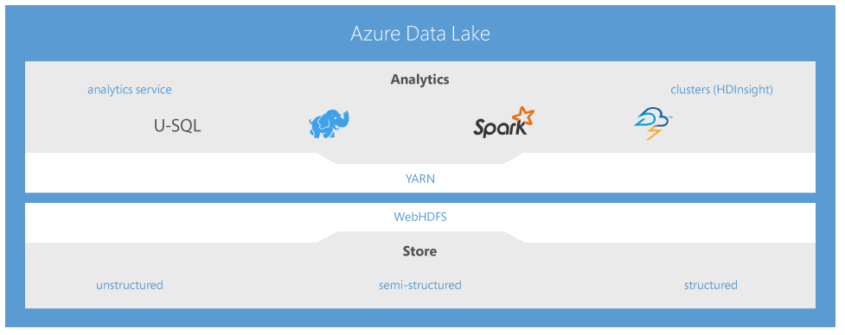
Date Lake
Hyper scale repository for big data analytics workloads. Azure Data Lake is secured, massively scalable, and built to the open HDFS standard, allowing you to run massively-parallel analytics.
Unlimited storage with Petabyte file sizes
No pre-defined schema
Structured, semi-structured and unstructured data in native format
Built for Hadoop compatibility
Pay for Storage in TB brackets and Transactions
Data Lake Analytics U-SQL to develop massively parallel programs with simplicity

Slide 15
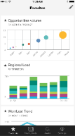
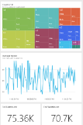
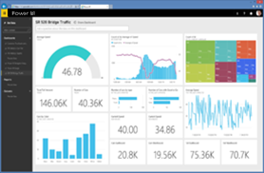
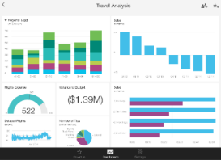
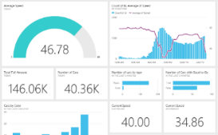

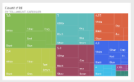


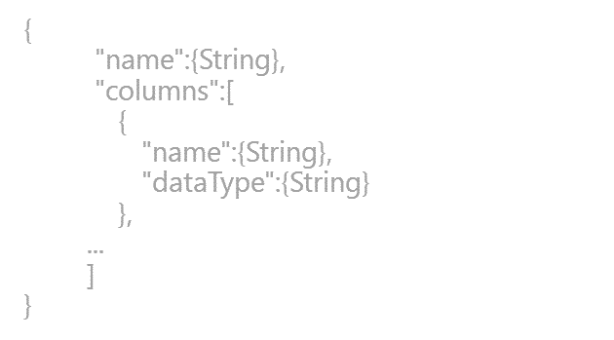
Power BI
Data sources
Power BI service
SaaS solutions
e.g. Marketo, Salesforce, GitHub, Google analytics
Content packs
Natural language query
Sharing & collaboration
On-premises data
e.g. Analysis Services
Live dashboards
Organizational content packs Corporate data sources or external data services
Visualizations
Azure services
Azure SQL, Stream Analytics…
Excel files
Workbook data / data models
Reports
01001
10101
Power BI Desktop files
Data from files, databases, Azure, and other sources
Datasets
0110001
00010110
Data refresh
Power BI Desktop
Power BI REST APIs
Prepare
Explore
Report
Share

Slide 16
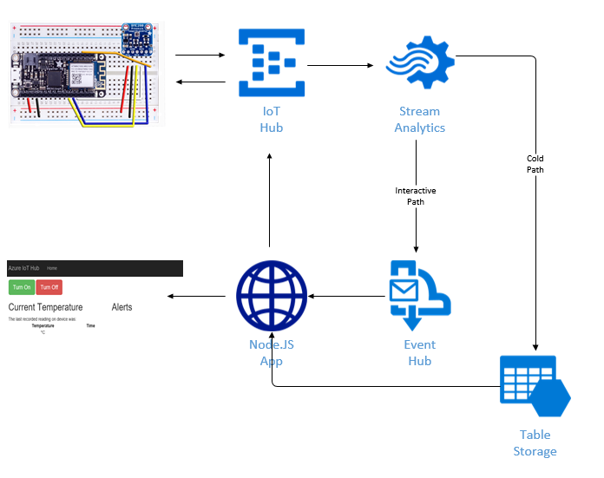
IoT

Slide 17
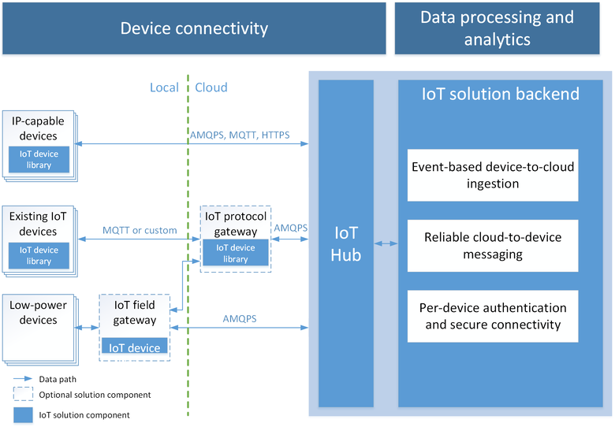
IoT Hub Connect, monitor, and manage billions of IoT assets
Telemetry ingestion
Millions of devices
Secure bi-directional communication
AMQP, HTTP, MQTT, …
Multiple platforms SDKs
Integration with Azure IoT Edge
Notes:
Stream millions of events per second into multiple applications
Event Hubs is a highly scalable publish-subscribe ingestor that can intake millions of events per second so that you can process and analyze the massive amounts of data produced by your connected devices and applications. Once collected into Event Hubs you can transform and store data using any real-time analytics provider or with batching/storage adapters.
Enable applications to process events with variable load profiles
Today’s connected world is defined by big data. Big data originates from many sources such as connected cars and thermostats that produce telemetry data every few minutes, application performance counters that generate events every second or mobile apps that capture telemetry for every user’s individual action. In this connected world, you need a managed ingestor service capable of elastic scale in order to accommodate variable load profiles as well as the spikes caused by intermittent connectivity.
Connect millions of devices across platforms
The rapid proliferation of connected devices raises challenges due to the variety of platforms and protocols involved. Connecting these disparate data sources while handling the scale of the aggregate stream is a significant challenge. Event Hubs provide easy provisioning of capacity to ingest events from millions of devices while preserving event order on a per device basis. Support for AMQP and HTTP allow many platforms to work with Event Hubs. Native client libraries also exist for popular platforms.

Slide 18
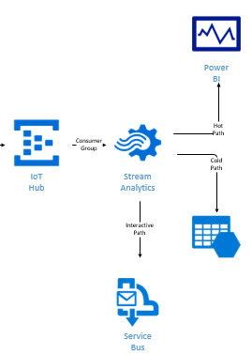
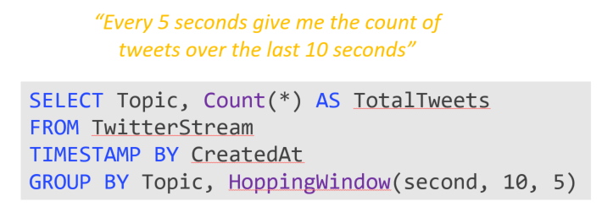
Azure Stream Analytics Real time event processing
Uncover real time insights
Perform real time analytics across multiple streams
Complex Event Processing model
Rapid Deployment
Use simple SQL syntax, auto distributed for scale
Mission critical reliability
Fully managed, low latency, high throughput
Create real time alerts
Flag alerts and alarms for attention
High volume and Scale
Analyze millions of data points per second
A 10-second Hopping Window with a 5-second “Hop”
1
5
4
6
2
8
6
5
3
6
1
0
5
10
15
20
25
30
Time
(secs)
1
5
4
6
2
4
6
2
8
6
8
6
5
3
5
3
6
1

Slide 19
Questions?

